Slide 1
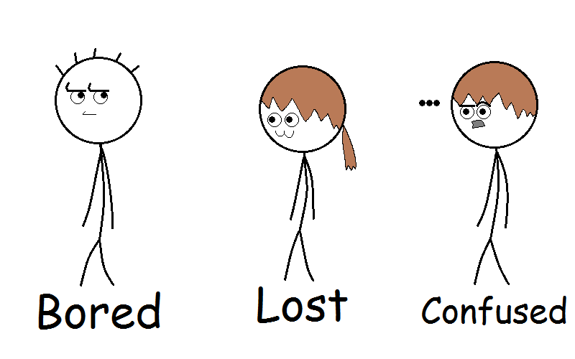
Who tests our tests?
A quest for high quality unit tests

Slide 2


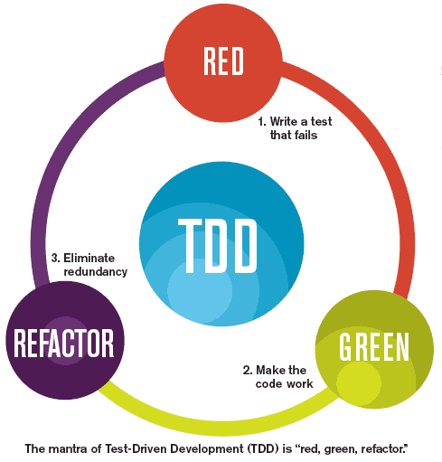

About(me)
Notes:
I work as part of the Control-M conversion tool for two years.
I like to read books about programming such as these

Slide 3
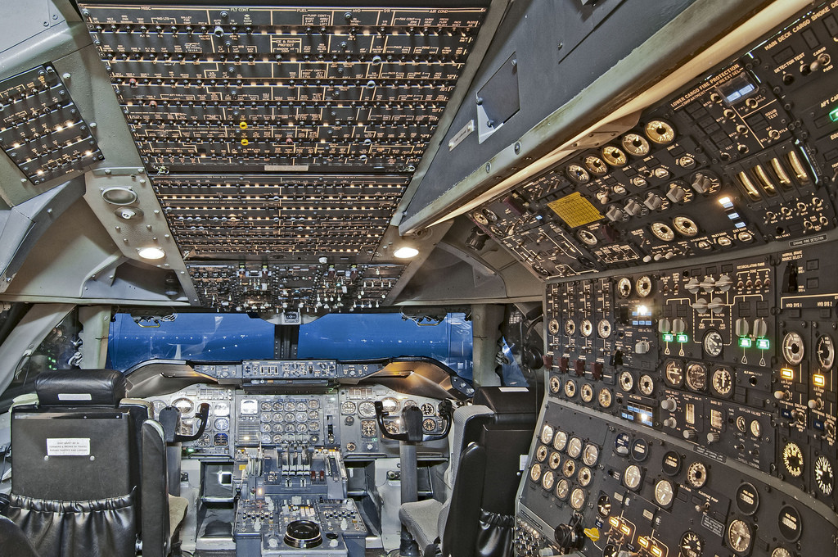
Can you manually test that?

Slide 4

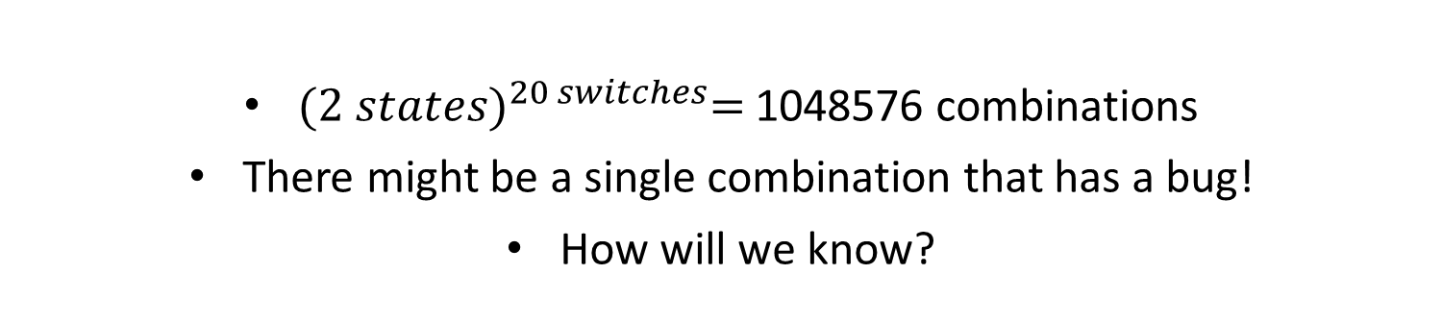
Testing all combinations is impractical
${(2 states)}^{20 switches}=$1048576 combinations
There might be a single combination that has a bug!
How will we know?

Slide 5
We will always have bugs…
One of Murphy’s computers laws:
“Software bugs are impossible to detect by anybody except the end user.”
Generally, we cannot prove that our software does not have any bugs

Slide 6
How can we deploy software fast? daily? confidently?

Slide 7
The vision of automated testing
Run tests
Wait
Passed!
Deploy ☺
Add new feature
Exploratory testing
(manual)
Notes:
What if you had a button that you can push, and within a few minutes, you can know if your product works?
This is the ultimate goal of writing automatic tests, and that is the value of having a good automation test suite.
But in order to do that, or at least get close to something similar, it requires a lot of work and high quality automation tests.
So let’s talk about unit tests…

Slide 8
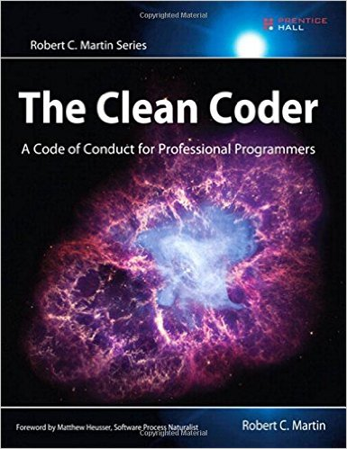
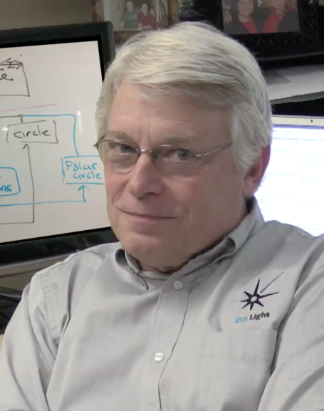
The bigger picture
Manual Tests
System tests (10%*)
Integration tests (20%*)
Component tests (50%*)
Unit tests (100%*)
Percentage of the system that should roughly be covered by each layer
The test automation pyramid
Notes:
Unit tests are just one piece of a bigger picture.
There are other kinds of tests, of course, and we need them all, but the reason that I chose to focus on unit tests is that they provide the highest ROI
The pyramid implies what is the volume of each layer
Unit tests – ideally 100% (at least 90%) – asymptotic goal
Component tests – about 50%
Integration tests – about 20%
System tests – about 10%
Let’s start with a good suite of unit tests…
Percentages for each layer

Slide 9
Unit tests

Slide 10
What is “a unit test”?
No clear definition
Tests a single “unit”
Limited scope
Written by the programmer
F.I.R.S.T
Fast (milliseconds), Isolated, Repeatable, Self-Validating, Timely
0.1 seconds is very slow for a unit test. We should aim for a few milliseconds per test.
Notes:
Who of you ever wrote a unit test?
We don’t have a single, clear definition that is accepted globally. Instead we have many different definitions.
Typically a unit test tests a single class.
I like the FIRST acronym – easy to remember and I also like to write my tests first, although that is not part of the definition.
I have included the Wikipedia definition, but I think it is easier to understand what is a unit test IS by talking about what it is NOT.

Slide 11
Example of a unit test – The three A’s
@Test
public void testSum()
{
Adder adder = new Adder(); //Arrange (Given)
int result = adder.add(1, 2);//Act (When)
assert(result == 3); //Assert (Then)
}

Slide 12

What is !”a unit test”?
Rephrasing Michael Feathers’ definition of a unit test:
A test is NOT a unit test if:
It is slow
It uses external resources
Involves manual effort
It is unreliable
Notes:
So what is NOT a unit test?
I have rephrased Michael feathers’ definition:
It is slow (100ms is considered very slow)
It uses external resources (Database, Network, Threads, File system, Threads, etc.)
Requires manual effort to confirm if it passed or failed
It is unreliable (e.g. passes only 99% of the time)
Requires manually changing the environment (such as configuration files) in order to run

Slide 13
Limitations of unit tests
Things can “blow up” in integration between “units”
Notes:
Example: If unit A talks to a database, its unit tests will not talk to the database. Instead the databse will be replaced by a dummy database. We need a test that actually uses the database, but it will not be a unit test anymore.

Slide 14
What is the main purpose of automated tests?
Notes:
So why do we write automated tests at all?
Let’s explore some of the reasons…

Slide 15
Trivial reasons
What is the main purpose of automated tests?
Faster than manual tests
Less error-prone than manual tests

Slide 16

Anatomy of change
What is the main purpose of automated tests?
 | Adding a feature | Optimizing | Refactoring | Fixing a Bug
Structure | Changes |  | Changes | Changes
New Functionality | Changes
Existing functionality |  |  |  | Changes
Resource Usage |  | Changes
Notes:
Michael feathers in “working effectively with legacy code” describes 4 reasons for why software changes (a simplification)
On the top we have the cause of the change
On the left we have the thing that is changing
Example…
We can derive several conclusions from this table,
But the one I want to focus on is this:
We can see that existing functionality should only change if we are fixing a bug. It should not change if we are adding a feature, optimizing our code or refactoring our code.
EXAMPLE: adding new drawing tool to paint application shouldn’t change any existing behavior

Slide 17
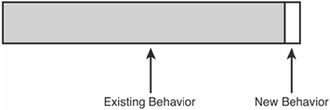
Fixing a Bug
What is the main purpose of automated tests?
Notes:
But when we fix a bug, the change in behavior is usually minor, compared to the rest of the system.
So that leads us to the conclusion that…

Slide 18
Preserving existing behavior
What is the main purpose of automated tests?
Is the main purpose of automated tests
The main purpose is NOT to find bugs
Notes:
So preserving existing behavior is the main purpose of automated tests.
But it turns out that doing this is not an easy task.
Writing an automated test suite that preserves the existing behavior is Hard and requires a lot of time, effort and expertise.
Which leads us to…

Slide 19
Why do we write unit tests?

Slide 20
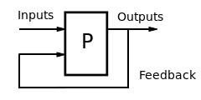
Feedback loop
Why do we write unit tests?
Higher cost
Longer feedback loop
Leads to
Notes:
What is a feedback loop?
It is the time between a new change we are making and some kind of feedback related to that change.
Generally, the longer our feedback loop is, the higher the cost of errors (both to us, and the organization)

Slide 21
Why do we write unit tests?

Slide 22
Big ball of mud
Why do we write unit tests?
A big ball of mud is a software system that lacks a perceivable architecture.
Example causes:
business pressures, developer turnover, code entropy, fear
A big ball of mud is software that is hard to maintain.
We need a tool to help us fight the big ball of mud.

Slide 23

Trusting our tests
Why do we write unit tests?
If we don’t trust our tests
we are afraid to make changes and clean our code (Refactoring)
Our code rots over time and is harder to maintain.
Notes:
We need a test suite that we can trust.
Trust that if it passes, the existing behavior of the system is indeed preserved.
If we don’t trust our tests, it is very easy to give up on writing them at all,
Or write bad tests that only increase the effort to maintain our code,
and might even lead us to a worse situation than if we didn’t have any tests at all.

Slide 24
Are we writing good unit tests?

Slide 25
Code coverage
Are we writing good unit tests?
Notes:
One of the tools we should use to track our automation tests progress is code coverage.
Code coverage lets us know which parts of our code base is executed by our tests (and which are NOT)
This enables us to see holes in our test suite, which we can cover by adding tests that cover the missing lines

Slide 26
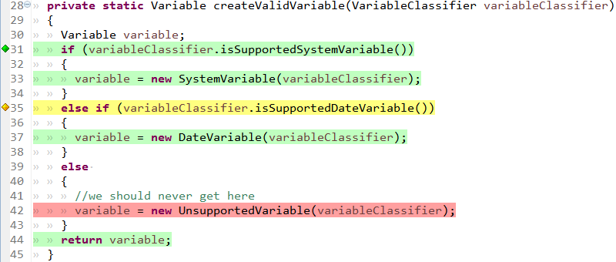
Code coverage - example
Are we writing good unit tests?
Notes:
We can see in GREEN the lines that were executed by our unit tests
In RED we can see lines that were not executed
In YELLOW we can see branches that were partially covered (always true or always false)

Slide 27
Limitations of code coverage
Are we writing good unit tests?
Code coverage tells us what is NOT being tested
It does not tell us that what is covered is REALLY tested.
Notes:
Extreme example: test without assertion
Sometimes, not all lines can be covered (if (true)) or the coverage tool does not track all the lines (firmware boot code is not covered until it activates some hardware component that tracks which lines are executed)

Slide 28
No assert – But coverage could be 100%
@Test
public void testSum()
{
Adder adder = new Adder(); //Arrange (Given)
int result = adder.add(1, 2);//Act (When)
//TODO: add assert!! //Assert (Then)
}

Slide 29
Disciplines
Are we writing good unit tests?
Code review
Pair programming
Test-Driven Development (TDD)
Notes:
Another tool we have are disciplines.
Disciplines are a mechanism that increases the chance that our quality will be higher and that we will create less errors

Slide 30
Limitation of Disciplines
Are we writing good unit tests?
Hard to measure
Disciplines are HARD!
Notes:
How do you get all team to pair program or practice TDD?
Easy to cut corners when its hard

Slide 31
Mutation testing
Are we writing good unit tests?
Raises our confidence that our unit tests will detect unwanted change
Measures the quality of our tests by the percentage of mutations killed
Notes:
Technique to measure the quality of our tests
Injects a fault into a system and uses our tests to find it
Proposed in 1971 by Richard Lipton

Slide 32
New concepts
Are we writing good unit tests?
Mutant:
Mutated version of a class
Mutation Operator:
Change <= to <
Negate conditional
Remove method call
Mutation coverage:
Percentage of mutants killed
Generating mutants
Notes:
Technique to measure the quality of our tests
Injects a fault into a system and uses our tests to find it
Proposed in 1971 by Richard Lipton

Slide 33
Are we writing good unit tests?
Original code
Mutant
Run Tests
Passed
Mutant survived
Failed
Mutant killed

Slide 34
Limitations of mutation testing
Are we writing good unit tests?
rm –rf “/” + foo
rm –rf “/” + “”

Slide 35
Mutation testing tools
Are we writing good unit tests?
Java – PIT(pitest) - http://pitest.org/
.NET - VisualMutator - https://visualmutator.github.io/web/
Python – mutate.py - http://arun-babu.com/mutate.py
Ruby, PHP, Haskell
https://en.wikipedia.org/wiki/Mutation_testing#External_links

Slide 36

PIT (pitest)
Are we writing good unit tests?
Java mutation testing tool

Slide 37
Demo

Slide 38
Conclusion
Good unit tests
Fast feedback loop
Reduce cost
Enables us to
Move faster
The main purpose of automated tests is to preserve existing behavior
Mutation testing
High quality tests
Sleep well at night
Mutation testing

Slide 39
Questions?

Slide 40
Sources
https://www.amazon.com/Working-Effectively-Legacy-Michael-Feathers/dp/0131177052
http://www.informit.com/articles/article.aspx?p=359418
http://pitest.org/
http://www.agilemodeling.com/essays/costOfChange.htm
http://www.artima.com/weblogs/viewpost.jsp?thread=126923
https://codingjourneyman.com/tag/uncle-bob/page/2/
http://www.slideshare.net/wlangiewicz/mutation-testing-in-java
https://en.wikipedia.org/wiki/Optimism_bias
http://www.cbs.gov.il/shnaton66/st03_01.pdf
http://www.lawlink.co.il/%D7%90%D7%97%D7%95%D7%96-%D7%94%D7%92%D7%99%D7%A8%D7%95%D7%A9%D7%99%D7%9F-%D7%91%D7%99%D7%A9%D7%A8%D7%90%D7%9C/
http://www.cbs.gov.il/publications16/1631/pdf/intro_e.pdf

